Slide 1
English Stylistics
Week 6 Phonological features (1)

Slide 2
Review: Rhetorical devices
Simile 明喻 & Metaphor 暗喻
Metonomy 转喻 & Synecdoche 提喻
Hyperbole 夸张 & Litotes 反叙/曲语
Antithesis 反衬 & Parallelism 排比
Oxymoron 逆喻

Slide 3
From The Tale of Two Cities
It was the best of times,
and it was the ______ of times.
It was the age of wisdom,
and it was the age of __________.

Slide 4
Continued …
It was the epoch of belief,
and it was the epoch of ________.
It was the season of light,
and it was the season of _________.
It was the spring of hope,
and it was the winter of _________.

Slide 5
Continued …
We had everything before us,
and we had ________ before us.
We were all going direct to Heaven,
and we were all going direct ______________.

Slide 6
Today’s class
English phonology
Phonemes vs. Supra-segmental features
Sound effect: phoneasthesia and onomatopoeic

Slide 7
Phonological units
Phonemes (or segments)
Supra-segmental features
→ Syllables
→ Stress
→ Tones and intonations

Slide 8
Sounds/ Phonemes in English
22 Consonants: /p/, /t/, …
12 vowels: /i:/, /u:/, …
2 semi-vowels: /w/, /j/
8 diphthongs: /ei/, /ou/, …
Consonant clusters：/pl/, /sp/, /sk/, …

Slide 9
“possible words” in English – coinage
swurd, macket, salering
pferd, schflap, btkinspq

Slide 10
Sound effect
Phonaesthesia: Sound symbolism
Onomatopoeia: Sound imitation

Slide 11
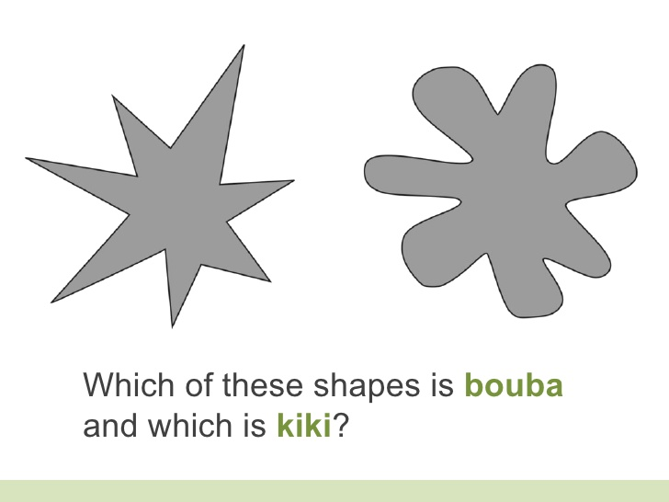
Sound symbolism
The Bouba vs. Kiki Effect
Synesthetic cross-modal abstraction
“Kate” vs. “Paula”

Slide 12
Phonaesthesia – vowels
Open vs. closed mouth
→ Splish – splash – splosh
Front vs. back vowels
→ tittle, bit, thin, slit, sliver
→ gloom, boom, loom

Slide 13
Phonaesthesia – consonants
/fl/ -- the sudden movement
E.g., flap, flare, fling, flick, flop, …
/gl/ -- light
E.g., gleam, glare, glint, glitter, glisten, …

Slide 14
Phonaesthesia – consonants
/sl-/: smooth surface
E.g., slippery, slide, slime, slushy
/-le/ or /-er/: repetition
E.g., bubble, twinkle, ripple, mutter, twitter, flutter

Slide 15
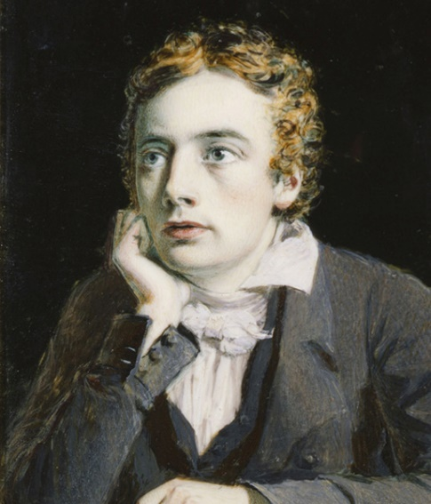
To Autumn (John Keats, 1795-1821)
And sometimes like a gleaner thou dost keep
Steady thy laden head across a brook;
Or by a cider press, with patient look,
Thou watchest the last oozings hours by hours

Slide 16
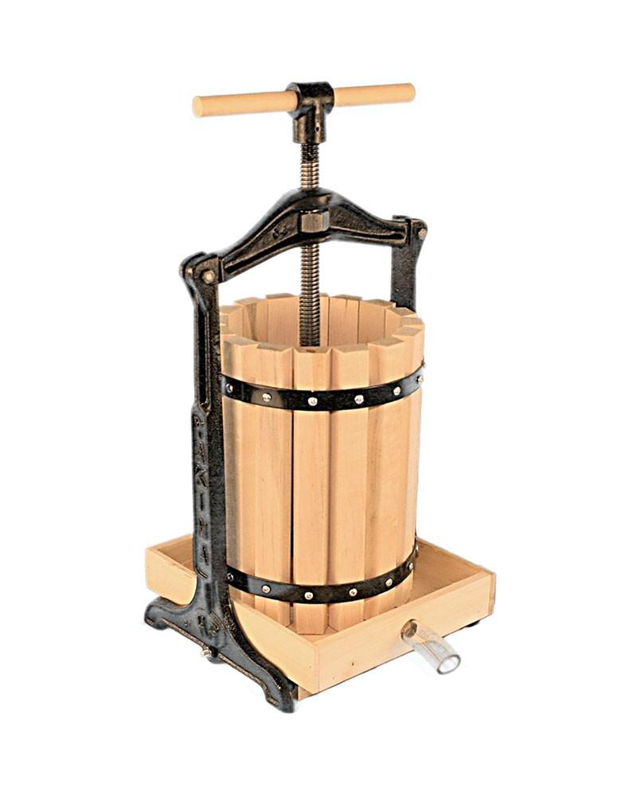
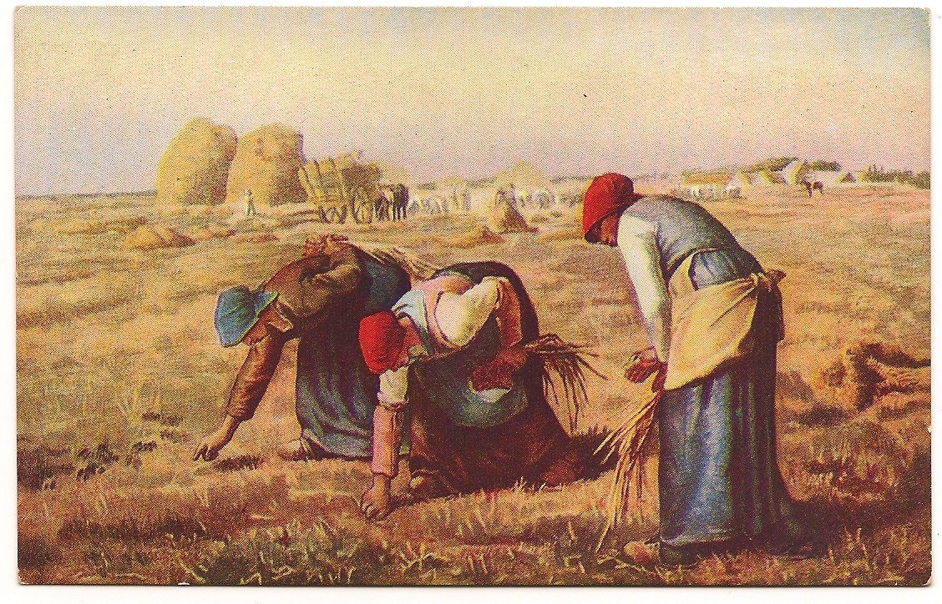
“gleaner” and “cider press”

Slide 17
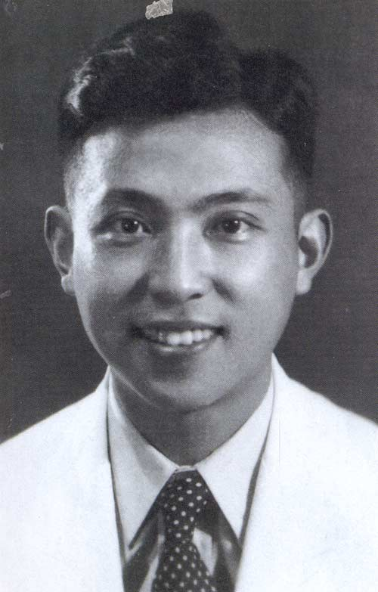
查良铮 （穆旦）译
或者，像拾穗人越过小溪， 你昂首背着谷袋，投下倒影， 或者就在榨果架下坐几点钟， 你耐心地瞧着徐徐滴下的酒浆。

Slide 18
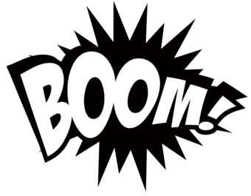
Onomatopoeia – sound imitation
Bang
Buzz
Hiss
Tick-tock

Slide 19
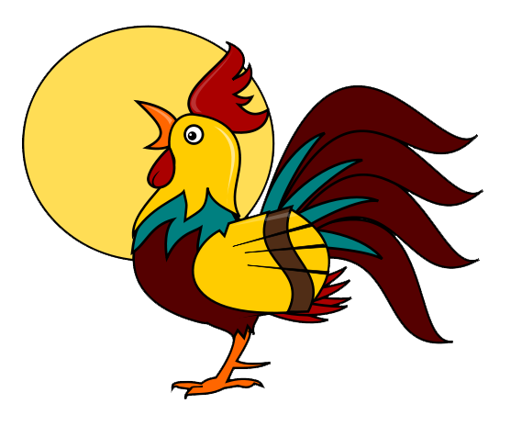
Rooster crowing
Arabic: koko-reekuu
English: cook-a-doodle-doo
French: cocorico
German: kikeriki
Indian: ku-kudu-koo
Russian: koo-ka-re-koo
Vietnamese: o-o-o

Slide 20
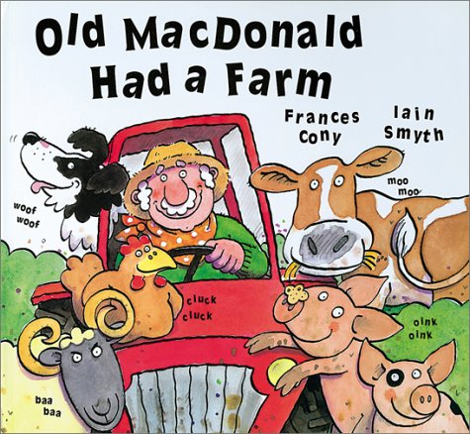
Woof woof
Moo moo
Baa baa
Cluck cluck
Oink oink

Slide 21
Onomatopoeia
Iconicity（相似性） of human language (vs. arbitrariness)
Vivid and impressive (nursery rhymes, comic books, advertisement, and literary works)
Universal phenomenon
Cultural differences

Slide 22
Lost in translation?
Crack! The stick broke in two.
Only the ventilator in the cellar window kept up a ceaseless rattle.
They splashed through the mire to the village.
The logs were burning briskly in the fire.
“Impertinent!” snorted the old man.

Slide 23
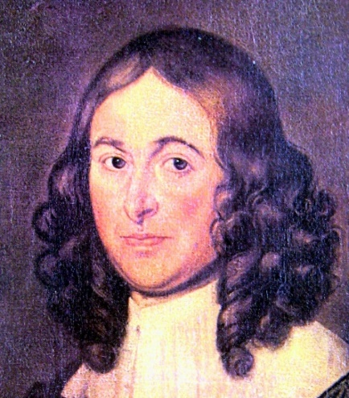
Spring (Thomas Nashe, 1567-1601)
Spring, the sweet Spring, is the year’s pleasant king;
then blooms each thing, then maids dance in a ring;
cold doth not sting, the pretty birds do sing;
Cuckoo, jug-jug, pu-we, to-witta-wo!

Slide 24
春（郭沫若译）
春，甘美之春，一年之中的尧舜，
处处都有花树，都有女儿环舞，
微寒但觉清和，佳禽争着唱歌，
啁啁，啾啾，哥哥，割麦、插一禾！

Slide 25
Summary
English phonology
→ sounds (segments, phonemes)
→ supra-segmental features
Sound effects
→ phonaesthesia
→ onomatopoeia

